Slide 1
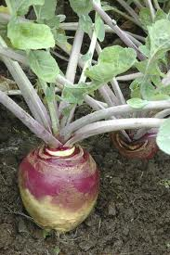
Rutabaga Seeds as a potential Export to Nepal
Shauna Chesney
University of Guelph
Notes:
Hello, my name is Shauna Chesney, and I am a 1st year student at the University of Guelph. My export idea to Nepal is a Canadian variety of rutabaga seeds, specifically the Thompson Laurentian variety.
http://www.cob.montevallo.edu/MIS267/UMGarden/Rutabagas.htm
https://commons.wikimedia.org/wiki/File:Flag_of_Nepal.svg

Slide 2
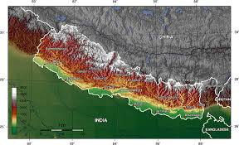
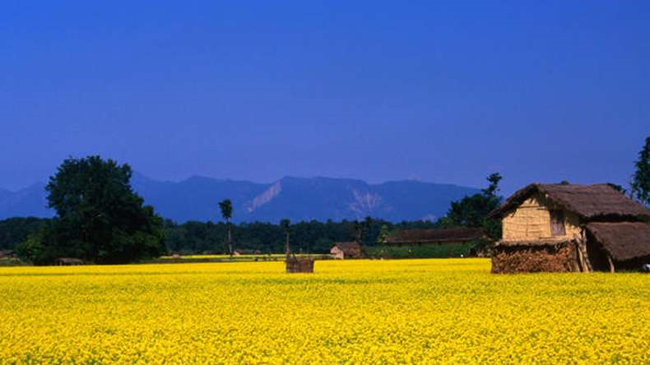
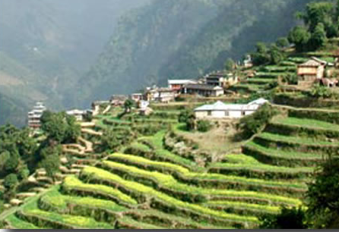
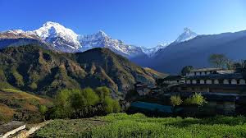
Nepal
Nepal is a land locked country found in
between China and India
Population: 27 million
80% involved in agriculture
It has three geological
regions
Terai region
Hills region
Mountain region
Notes:
Nepal is a small country in Asia the is found in between India and China. Agriculture is very important in Nepal with 80% of the 27 million population, working in the industry. There are three geological regions in Nepal that are involved in agriculture, the Terai region (the most productive agricultural region), the hills region which uses terraces for farming, and the mountain region which has a short growing season and includes the Himalayas.
https://en.wikipedia.org/wiki/Geology_of_Nepal
http://thehimalayancafe.com/gallery/HimalayanCafePhotoGallery/01-terrace-farming-landruk-village.html
http://holeintheclouds.net/taxonomy/term/1064
http://www.newsx.com/world/18279-multi-billion-rupee-development-plan-for-nepal%E2%80%99s-terai-region

Slide 3
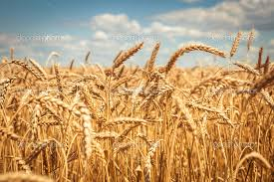
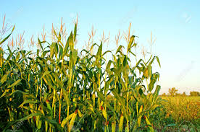
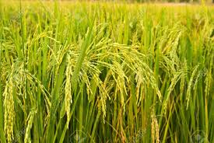
Common Crops Found in Nepal
The most common crops are..
Corn
Wheat
Rice
Farmers have limited choice in crop variety
Notes:
The crops grown in Nepal varies per region, however the most common crops are corn, wheat and rice. Farmers in all three regions have limited choice when it comes to crop variety and that is where rutabagas seeds would come into play.
http://www.123rf.com/photo_10510662_corn-plant.html
http://www.123rf.com/photo_9398506_rice-plant-in-rice-field.html
http://depositphotos.com/48977995/stock-photo-golden-ripe-wheat-field-sunny.html

Slide 4
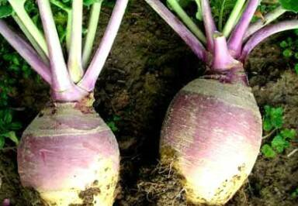
Rutabagas

Slide 5
What are Rutabagas?
Scientific name
Brassica napus var. napobrassica
A cross between a cabbage and a turnip
Many different varieties including
Thompson Laurentian variety
Can be used for both human and animal
consumption
Notes:
Rutabagas, Brassica napus var. napobrassica, are a root vegetable that is a cross between a turnip and a cabbage. This vegetable can be used for human and animal consumption
http://www.cob.montevallo.edu/MIS267/UMGarden/Rutabagas.htm

Slide 6
Nutrition
Rutabagas are an excellent source of
Vitamin C
Helps prevent survey
Fiber
Potassium
Vitamin A
Deficiency causes blindness
It is important to provide a food source that is nutritious to help prevent malnutrition
Notes:
. It also provides an excellent source of vitamin C, fiber, potassium and vitamin A. The vitamins are particularly important as they help prevent survey and blindness.
https://breakingmuscle.com/nutrition/the-abcs-of-vitamins-vitamin-a
http://www.naturalhealth365.com/category/vitamin-c/

Slide 7
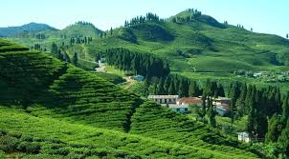
Where in Nepal will rutabagas grow?
Rutabagas are a cool season crop
They grow best in temperatures between 15°C and 20°C
In Nepal the region that is best suited to grow rutabagas is the Hills region
Average temperature during the growing season is 13°C to 27° C
Notes:
. Rutabagas are a cool season crop, meaning it grows best at lower temperatures, between 15 and 20°C and will even survive temperatures as low as -3°C. In Nepal, this crop would be best suited for the Hills region as the average temperature during the growing season is 13 to 27°C.
https://www.kullabs.com/class-10/environment-population-and-health-10/biodiversity/biodiversity-by-ecological-belts

Slide 8
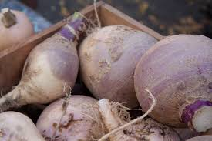
Harvesting
The Thomson Laurentian variety matures in 85 days
Usually harvested when 3 inches in diameter
Can grow much larger, however
Harvested by hand
Once harvested, can store up to 9 months
Notes:
The Laurentian Thompson variety only takes 85 days to have a mature root. Harvested rutabagas are usually 3 inches in diameter, however, they can grow much bigger. In Nepal, the vegetable would be harvested by hand once maturity has been reached. Once harvested, rutabagas store very well and can keep up to 9 months if handed properly.
http://www.gardeningknowhow.com/edible/vegetables/rutabaga/harvesting-rutabaga.htm

Slide 9
Benefits to Nepal
Great source of Vitamin A
19.6 % of women and 32.2% of children in Nepal vitamin A deficient
Helps provides a stable food source
6.9 million in Nepal are food insecure
Can be a source of food for animals
Can be sold for money
Helps create more diverse options for cultivars
Disease helps prevent attacks from pests and disease
Notes:
Exporting rutabaga seeds to Nepal would greatly benefit the country in many ways. As mentioned before rutabagas are a great source of many vitamins and minerals. Vitamin A would be a particularly important as 19.6 % of women and 32.2% of children in Nepal vitamin A deficient. It is important that they have a food source that is nutritious to help prevent malnutrition. Food insecurity is a major issue in Nepal with 6.9 million people food insecure. Since rutabagas can grow quickly, and store very well, rutabagas can be a stable food source for many Nepalese in the Hills region. Also, once harvested, the rutabagas can be sold, to help farmers earn a small profit. They can also be used as a food source for animals. Exporting rutabagas will also help provide the Nepalese with more options of crops to grow. Having diversity in cultivars, helps prevent attacks from pests and disease.
https://commons.wikimedia.org/wiki/File:Flag_of_Nepal.svg

Slide 10
Exporting From Canada
The company involved is NORSECO
Based in Montreal, Quebec
Selling Thompson Laurentian variety for $2.20 CAN per thousand seeds
Equals 175.30 rupees
Notes:
The company that would be associated with this export is NORSECO, a company based in Montreal. This company sells a variety of different seeds including many different types of vegetables. This company sells the seeds for $2.220 CAN per thousand seeds. This would equal 175.30 rupees, in Nepalese currency.

Slide 11
Benefits to Canada
Rutabagas are biennial
Takes two years to produce seed
Canadian farmers would produce the seeds as the Nepalese would use the rutabagas primarily as a food source
Farmers would be provided with contracts to provide the seeds
Processing a large amount of seeds can also provide jobs in the company’s warehouse in Laval, Quebec
Notes:
Rutabagas are biennial, they take two years to produce seeds. Since the Nepalese would use this vegetable as a food source, they would rely on Canadian farmers to produce the seeds. Canadians producing the seeds, would be supplied with contracts from companies like NORSECO. Also, processing a large amount of seeds, would help create jobs in NORSECO’s warehouse in Laval, Quebec.
https://en.wikipedia.org/wiki/Flag_of_Canada

Slide 12
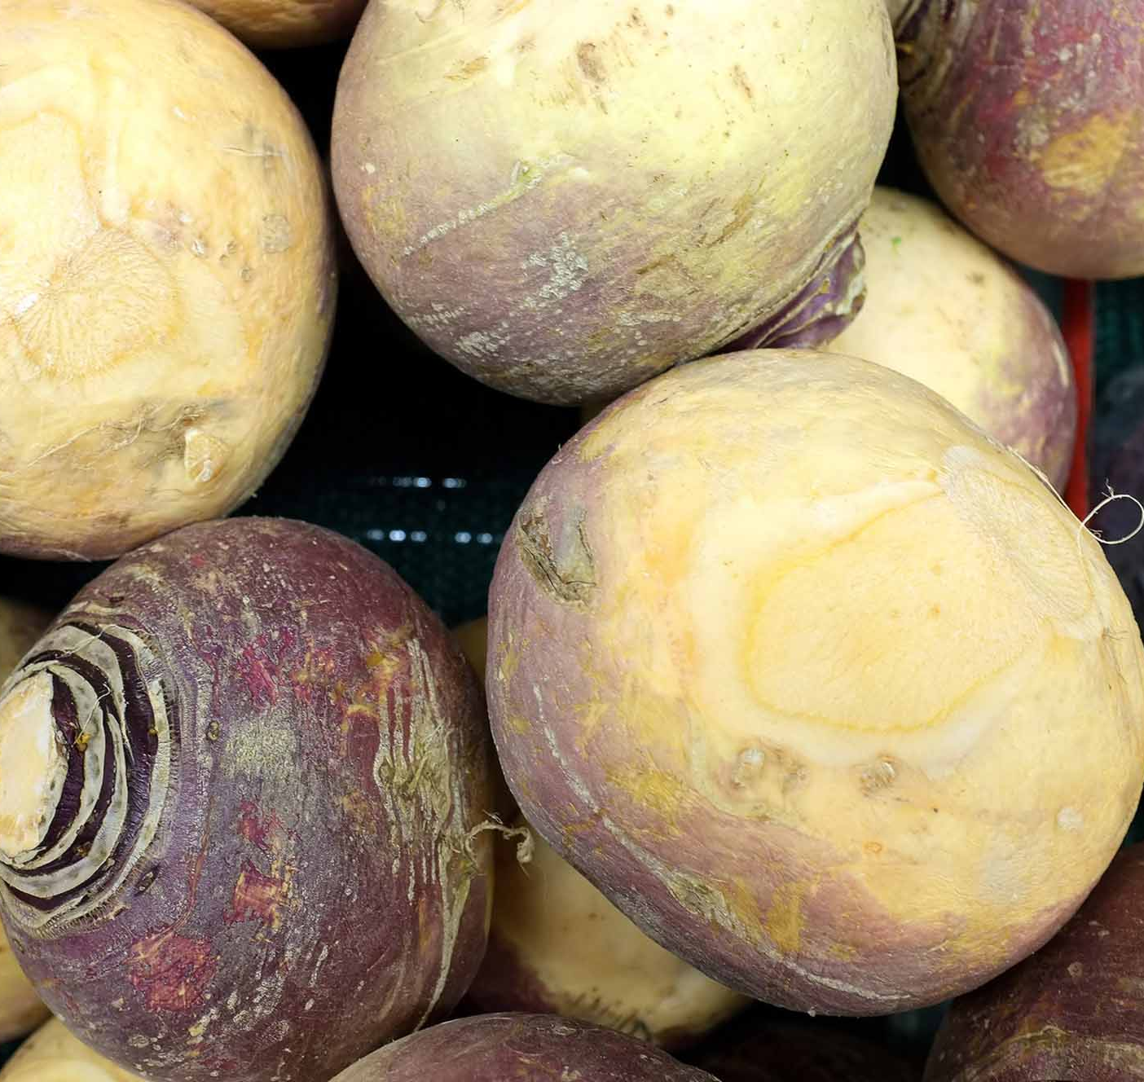
Conclusion
Rutabaga seeds would be an good export to Nepal as it would be an excellent food source and provide diversity to the crops grown in that country. It will also provide Canadians with job opportunities.

Slide 13
References
Agriculture and Agri-Food Canada. (2014) Crop Profile for Rutabaga in Canada, 2012. (Catalogue No.:A118-10/23-2014E-PDF). Ottawa, ON: Agriculture and Agri-Food Canada.
Conroy, C., Joshi, K.D., Witcombe, J.R. (2012). Agriculture, seed, and innovation in Nepal: Industry and policy issues for the future. International Food Policy Research Institute. 1-60.
Department of Fisheries, Forestry and Agrifoods. (2016). Rutabaga and turnip: vegetable crops production guide for the Atlantic provinces. Retrieved from http://www.faa.gov.nl.ca/agrifoods/plants/pdf/turnip.pdf
Dunea, G., Last, J.M., Lock, S. (2006) The Oxford Companion to Medicine (3 ed.). Oxford University Press.
Food and Agriculture Organization of the United Nations. (2010). Assessment of Food Security and Nutrition Situation in Nepal. Retrieved from ftp://ftp.fao.org/TC/CPF/Country%20NMTPF/Nepal/thematic%20studies/Food%20Security%20_Final_.pdf
Joshi, K.D. (2000). Strengthening the Farmers’ Seed System in Nepal. Biotechnology and Development Monitor, 42, 15-17.
NORSECO. (2013) Laurentian Thomson. Retrieved from http://www.norseco.com/en/24630-laurentian-thomson.html
Pariyar, D. (1999). Country pasture/ forage resource profiles: Nepal. Retrieved form http://www.fao.org/ag/agp/agpc/doc/counprof/nepal.htm
Pleasant, Barbara. 2013. "All about Growing TURNIPS AND RUTABAGAS." Mother Earth News, Aug, pp. 27 (http://sfx.scholarsportal.info/guelph/docview/1419723516?accountid=11233).
Shrestha, R.K. (2016). Agroecosystem of Mid-Hills. Retrieved from http://www.fao.org/docrep/004/t0706e/T0706E02.htm
Spaner, D. (2001). Agronomic and horticultural characters of rutabaga in eastern Canada. Canadian Journal of Plant Science, 2002, 82(1): 221-224, 10.4141/P01-086. Retrieved from http://www.nrcresearchpress.com.subzero.lib.uoguelph.ca/doi/abs/10.4141/P01-086#.WAUrrUlTHIX
World Health Organization. (2016) Nutrition landscape information system country profile: Nepal. Retrieved from http://apps.who.int/nutrition/landscape/report.aspx?iso=npl

Slide 14
Thank you
Shauna Chesney
University of Guelph in partnership with IDRC, CIFSRF and DFAIT
Faculty Sponsor: Prof. Manish Raizada (raizada@uogulph.ca)
Total presentation time 4 min 30 s
For further information a detailed written evaluation of this export idea is posted on this website
Notes:
Rutabaga seeds would be an good export to Nepal as it would be an excellent food source and provide diversity to the crops grown in that country. It will also provide Canadians with job opportunities. Thank you for your time.

